Slide 1

MICHIGAN
ODYSSEY OF THE MIND
COACHES’ TRAINING
Based on The “Unofficial” On-Line Coaches’ Training - by T.Perkins (VT), J. Otte (NY), & S. Riggs (TX)
& Wisconsin Odyssey of the Mind Coaches Training - wi.odysseyofthemind.org/Documents/CoachesTraining.ppt
Notes:
Introductions
Bathrooms, water fountain, coffee
Hand show old vs new coaches
Anybody totally new to OM

Slide 2


Before We Begin
Two main references in today’s presentation
PG 5
CM 1
Notes:
Show both publications
Program Guide online @ member area
Explain PG & CM notations

Slide 3
What is divergent-thinking?
Convergent Problem Solving
For every problem, there is
just one correct answer
Divergent Problem Solving
For many problems, there are
many correct answers
Answer
Answer
Answer
Answer
Answer
Answer
Answer
Answer
Answer
Answer
Answer
Answer
Answer
Answer
Answer
Answer
Answer
Answer
Odyssey of the Mind encourages exploration of many possible answers and creativity in finding a solution
Because there are no wrong solutions, teams are free to take calculated risks in attempting to solving the problem
Odyssey of the Mind allows kids to use their imaginations to interpret and solve complex problems in a FUN way!

Slide 4



The Three Components of OotM
Long-Term (LT)
200 Points
Specific rules
Open-Ended
Solutions presented
In skit form (8-min)
Style
50 Points
Elaboration of
Long-Term solution
Pizazz, sparkle, polish
Team chosen elements
Spontaneous
100 Points
On the spot
Anything goes
3 Types: Verbal,
Hands-on, Hybrid
PG 20
CM 1

Slide 5
The Three Components of OotM
Long-Term
+ Style
+ Spontaneous
= Total Score

Slide 6
Program Structure – Memberships
Each Membership must
  Pay National Membership fee ( $135 )
  Pay State Membership fee ( $60 )
  Provide at least one trained judge for the Regional tournament
Each Team must:
  Pay Regional Tournament fee ( $50)
  Provide at least one trained judge for Regional and State tournament (if advancing)
  Provide one Volunteer for Regional and State tournament (if advancing)
PG 16
CM 4

Slide 7
Program Structure - Teams
Teams participate within divisions.
A team’s division is based upon the grade level of the team’s oldest member.
  Primary (usually K-2nd grade)
  Div I (every team member in K-5th grade)
  Div II (at least one team member in 6th-8th grade)
  Div III (at least one team member in 9th-12th grade)
  Div IV (all members with high school diplomas and taking at least one college course)
PG 17
CM 7

Slide 8
Program Structure - Teams
Teams of 5-7 students participate in:
  Team’s choice of the Long-Term problems for that year
  A Spontaneous problem assigned at competition
  This includes Primary teams!
All team members may participate in the Long-Term presentation.
A maximum of 7 “minds” can work on the team’s Long-Term problem. (In other words, No Outside Assistance!)
Only 5 team members may participate in Spontaneous problem (Team members will choose which 5) Additional team members may observe Spontaneous competition.
PG 18

Slide 9
Getting Started
Generating Interest
Forming Teams
  Finding team members
  Adding team members
Parent Meeting
  Calendar
  Expectations
  Coaches Bill of Rights
  Judges and Volunteers
  Outside Assistance

Slide 10

Typical Timeline
Sep – Nov Membership Coordinator:
        Purchase memberships
        Form teams, recruit coaches
        Pay State team fee
Nov - Dec Coach: Attend coaches training
Nov - Mar Team: Work on LT solution, practice Spontaneous
Dec - Jan Coach: Sign-up for tournament (early if possible)
Jan 10 Coach: Deadline to register for State and Region Deadline to register Judges & Volunteers
Feb Judges: Attend Judges’ training
Feb 8 Regions 1 & 5 Tournaments
Feb 15 Regions 3 & 4 Tournaments
Feb 22 Regions 2 Tournament
Mar 14 Michigan State Tournament: Middleville, MI
May 27-30 World Finals: Iowa State University

Slide 11
What is the role of the coach?
Schedule meetings & Organize snacks – Busy minds need fuel
Facilitator – help team to:
  Set goals, develop a timeline, track tasks & deadlines
  Understand problem including scoring and clarifications
  Take notes - without making suggestions or directing
  Lead brainstorming sessions - without injecting ideas
  Bring in “experts” to discuss and teach skills
Teach basic skills - Sewing, carpentry, painting, make-up, etc …
Ask open-ended QUESTIONS (to help team focus)
Guide team in Spontaneous practice at every meeting
Guide team through forms
All Around Go-fer & field trip coordinator
PG 7
CM 9

Slide 12
Tips and Advice
Arrange for a Co-Coach or back up person for the team.
Have the team develop a timeline and stick to it.
Learn to recognize burnout and when to lighten up.
Know the OotM Long-Term problem and the OotM Program Guide inside out, upside down and backwards.
Plan on mistakes, disappointments, and disagreements. Decide early how you, as a team, will handle them.
Always answer a question with a question.
Learn how to ask questions. Become an expert at this skill.
Be a real resource person. Take the team on “field trips”
Teach skills and attitudes to help anticipate problems.
CM 9

Slide 13
Tips and Advice Continued…
Look at the answer or solution. Have team members ask:
  Is it of high quality?
    How original is it?
      Is it the first thing you think of?
        Is it the first thing others will think of?
          If so, is it creative?
Remember that it is the team’s attention to details that will differentiate good solutions from great solutions.

Slide 14
Coaching Do’s
Do help students to see and recognize the abilities of each team member and encourage team members to capitalize on the individual strengths of ALL.
Do help students to understand that winning is not the goal. The process of getting there is the most important thing -- not the competition.
Do help them give and take constructive criticism of IDEAS and avoid insulting remarks.
Do relax and enjoy seeing these young, creative minds at work!!
CM 11

Slide 15
Coaching Don’ts
Don't tell them how to solve the problem, but rather ask questions which help them think it through.
Don't limit creativity by setting restrictions which are too tight or which reflect your own, perhaps limited, vision.
Don't get disturbed when teams make mistakes along the way. This is part of the OM learning process.
Don't allow any criticism of teammates' personalities or physical attributes -- no cutting remarks.
CM 12

Slide 16
Team Meetings
How often?
Meeting Structure
  Team Building
  Brainstorm
  Work on Problem Solution
  Spontaneous
  Snack

Slide 17
The First Five - Meeting #1
Meet with team and parents to explain program and set team goals
Discuss the process, give dates for tournaments
Go over the time commitment and responsibility of being on the team
Stress regular attendance at meetings
Explain Outside Assistance
Review behavioral expectations
Talk about difference between “winning” and “succeeding”
Set a meeting schedule
PG 9
CM 14

Slide 18
The First Five - Meeting #2 - 5
Every meeting
  Incorporate a team-building activity
  Practice a couple Spontaneous problems
#2 Talk about skills and interests of team members
  Explain Spontaneous and relevance to scoring
#3 Have team decide on Long-Term problem (vote?)
  Brainstorm possible solutions to LT problem
#4 Read the Specific Long-Term problem rules
#5 Brainstorm list of tasks to accomplish and timeline
  Assign tasks and discuss team responsibilities
  Ask for help if you need it
PG 10
CM 14

Slide 19
Coaches “Bill of Rights”
You have the right to ……
  Expect appropriate behavior from all your team members
  Expect team members to attend scheduled meetings
  Expect help from your team members’ parents
  Expect parents to share the costs of creating the solution
  Remove a child from a meeting if they can’t behave
  Call a child’s parent’s if a problem occurs or recurs
  Remove a child from your OotM team if attempts to modify their behavior fail
  Have a life outside of Odyssey of the Mind
CM 16

Slide 20
Teambuilding
It is important that your group comes together and functions as a team. Important decisions should be made together.
Incorporate some team-building games into each practice session, especially early in the season. This will build team trust, and teach students to work together to solve problems.
Do not allow criticism of people or their ideas. It is okay to evaluate ideas on their merits, but it must be done constructively.
Celebrate milestones, breakthroughs and accomplishments.
Once an idea is generated and discussed, it is no longer owned by the originator….it is the TEAM’S idea.
PG 11
CM 15 & 43

Slide 21
Long-Term
Problem Solving

Slide 22
What's needed to get started with our Long-Term problem?
There are 3 major information resources that are available to you as a coach of an Odyssey of the Mind team
  Program Guide (available on the official website or through your membership coordinator)
  Long-Term Problem (available from your membership coordinator or the official website )
  Clarifications general and team (available on the Odyssey of the Mind website, through your coordinator, or through your State Association; released throughout the season)

Slide 23
The Long-Term Problems
  Six new Long-Term problems are written by Creative Competitions, Inc. each year.
  There is a cost limit to each problem (usually ~ $125 - $145)
  Solutions cannot be “bought”, they must be designed and built by the team
  Only the materials used in competition are included in the cost
  Duct tape & cardboard, garage-sale value, scavenging
  Some “standard” and safety items are exempt from cost, these are listed in the Program Guide.
  All have a theme with a skit and are performed in 8 minutes
PG 20
CM 1

Slide 24
The Long-Term Problems Continued…
Participation requires a commitment from:
  Team members
  Coaches
  Membership Coordinators
  Volunteer Judges
  Volunteer Officials

Slide 25
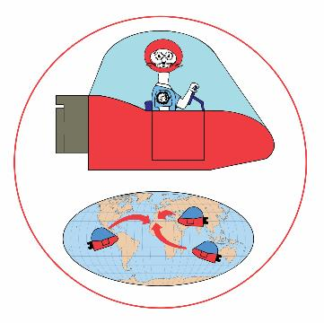
The Long-Term Problems Continued…
Problem #1 - Vehicle - Longshot Solution
Teams design, build and operate one or more vehicles. Sometimes they’re small, other times they’re big enough to ride on and transport other items. Generally the vehicles are scored on their propulsion system, and for traveling and completing different tasks.
PG 20
CM 3

Slide 26

The Long-Term Problems Continued…
Problem #2 - Technical - Net Working
Teams are scored for performance elements as well as for some type of technical achievement. Usually, this problem requires the team to create one or more devices that perform certain functions or tasks.
PG 20
CM 3

Slide 27

The Long-Term Problems Continued…
Problem #3 - Classics… The Effective Detective
This is a performance problem based on something “classical.” It could involve mythology, art, music, archaeology, or anything else that is classical in nature.
PG 20
CM 3

Slide 28

The Long-Term Problems Continued…
Problem #4 - Structure - Balsa Limbo
Teams design and build a structure out of only balsa wood and glue. They test the structure by adding Olympic-size weights until it breaks. Each year there is an element of the problem that sets it apart from other years, for example, having the structure endure the impact of a ball propelled down a ramp.
PG 20
CM 3

Slide 29

The Long-Term Problems Continued…
Problem #5 - Theatrical - Gibberish or Not
This is strictly a performance problem, where scoring is based mostly on the performance and elements within the performance. It sometimes requires a specific character, sometimes humor, sometimes an original story, but it’s always fun!
PG 21
CM 3

Slide 30

The Long-Term Problems Continued…
Primary Problem - The Fashion Bug
Non-Competitive
Designed to introduce younger students (Grades K-2)
to the creative problem solving
process.
PG 25
CM 3

Slide 31

Parts of a Long-Term Problem
Introduction
A. The Problem
B. Limitations
Notes:
Problem section outlines Spirit of Problem
Limitations gives specific expectations

Slide 32
Parts of a Long-Term Problem
E. Penalties
F. Style Scoring
C. Site, Setup &
Competition
G. TD Provides
H. Team Provides
D. Long-Term Scoring
I. Glossary
Notes:
Site & setup gives minimum specs
Scoring specifics – where will you get the most bang for your buck
Penalties lists range of possible
Style – 5 required style elements, 1 is overall
TD provides – minimum provisions, don’t ask for site specifics. Room unavailable?

Slide 33
How to solve the problem
Step 1 Read the Problem, then read it again!
  Go through each section of the problem carefully.
  Figure out the requirements of the problem and the scoring elements. Make sure each participant understands what is required of the problem.
  Understand how each of the parts interact.
  General ideas are OK, but don’t narrow your focus too fast
Step 2 Brainstorm Possible Solutions
  Generate lots of ideas (keep track of them on paper, chalkboard, or whiteboard)
  Don’t evaluate ideas yet… just list them.
  Break the problem down into manageable pieces
  Encourage wild, creative solutions
CM 23

Slide 34
How to solve the problem Continued…
Step 3 – S.C.A.M.P.E.R.
Substitute
Combine
Adapt
Modify, magnify, minimize
Put to Other Uses
Eliminate
Reverse or Rearrange
Step 4 – Refine and Evaluate Ideas
  Which ideas does the team like best? Why?
  Discuss and evaluate ideas, but don’t criticize
  Modify ideas to make them better.
  Select a preliminary solution.
CM 31

Slide 35
How to solve the problem Continued…
Step 5 – Determine Tasks and Timeline
  What types of tasks, skills, props, contraptions, are needed?
  Who and how will they do these things?
  Determine a basic time-line for completing the solution.
  Continue to evaluate the solution and refine/revise as needed.
  Do the items decided upon fit the problem specifications?
Step 6 – Begin Construction
  Start building and writing.
  Evaluate new ideas as they arise.
  Test the solution. Does it work?
  Can it be made to work better?
  Continuously refine and revise.
CM 32

Slide 36
How to solve the problem Continued…
Step 7 – Put it Together (At least one month before tournament)
  As props and tasks are near completion, or are completed, test them thoroughly.
  Continue to refine & revise your solution
    Does it work? Is there a better way?
    Does the solution still fit the problem?
    What problems need to be fixed?
Step 8 – Finish Up and Practice
  Test things out… do they work? Revise and refine.
    Can they work better?
    What happens if something goes wrong?
    Is there a contingency plan?
  Practice the whole performance and check the timing. Have team explain how they did it? Look for problem spots.
CM 32

Slide 37



Do it with Style

Slide 38
Style
Style is the place for the team to
showcase their strengths and talents.
Style is the elaboration of the Long-Term Problem. It is how the team makes their solution stand out from the rest. Style is presented during their Long-Term Problem Solution performance. What makes this performance really shine?
  Artistic design, music, songs, choreography
  Construction, creative use of materials
  Humor, rhyme …….
5 Categories (some mandatory, some team-choice, overall effect)
  Choose carefully and BE SPECIFIC!
PG 22
CM 35

Slide 39
Common Style Categories
Painting or artwork
Make-up or hair
Costumes
Props
Songs or music
Rhythm or rhymes
Sound effects
Poems or chants
Decorations
Original Poetry
Membership Sign
Scenery or Set
Dancing or marching
Humor
Materials or technique
"Details"
Descriptive prose
Narration
Character interaction
Lighting
Etc, etc, etc…..
PG 24
CM 38

Slide 40
Outside Assistance (OA)
OotM is Hands-On for Kids,
but Hands-Off for Adults!
OUTSIDE
ASSISTANCE
One of the most important parts of OotM is that the team must conceive, design, construct, and perform their own ideas. Help external to the team is termed “Outside Assistance”.
The solution is the team’s design, their work, their performance, and their score. The team is responsible for their results, not the coach.
It’s VERY important that parents know OA rules too!
PG 45
CM 19
Notes:
Just a reminder………
We’ll go over this in depth later

Slide 41
Is It OA or Not OA?
Outside Assistance
A team decides it will center its skit on a CELL theme. The coach gives the team members a homework assignment to come up with as many words as possible that contain the word CELL, such as cellophane, cellular phone, etc.
Answer: Not OA – Although the coach should not give the team any examples, the assignment is one of the types of things the coach should do to help the team develop its creativity.
Rationale: It is not OA for a coach to give a homework assignment that gets the kids to think more creatively about an initial idea that they came up with.
CM 20
Notes:
41

Slide 42
Is It OA or Not OA?
Outside Assistance
A Division I team is spray-painting a prop and the coach holds a team member’s hand for about 2 seconds (out of a 30-minute job).
Answer: It is OA – The coach may not help spray paint anything used in the solution. However, the coach may teach the team member how to spray paint by using something that is not part of the solution such as a scrap piece of wood.
Rationale: It is not OA for the coach to teach a team member the proper way to spray paint on a practice/scrap piece
CM 20
Notes:
42

Slide 43
Outside Assistance (OA) Take two …
OotM is Hands-On for Kids,
but Hands-Off for Adults!
OUTSIDE
ASSISTANCE
Team’s design
Team’s work
Team’s words
Team’s performance
Team’s score
Team’s results

Slide 44
Penalties
Penalties are designed to prevent teams from bending or breaking
the rules, creating a safety hazard, interfering with other teams,
delaying competition or misbehaving.
  Spirit of the Problem – Aimed at preventing teams from circumventing the intention of the rules in either Long-Term or Spontaneous
      Penalty between 1 to 100 points
  Unsportsmanlike Conduct – For intentionally (or even unintentionally) impairing another team’s solution, disruptive behavior, inappropriate language, damage to facilities. Penalties can be applied retroactively.
      Penalty between 1 to 100 points
PG 44

Slide 45
Penalties Continued…
  Outside Assistance – If team receives help from anyone. This applies to audience as well. Thus teams shouldn’t encourage audience participation
      Penalty between 1 to 100 points
  Incorrect / Missing Membership Sign
      Penalty between 1 to 15 points
  Over Cost Limit – Materials over cost limit
      Penalty between 1 to 100 points
  Over Time Limit – For each 10 seconds or fraction
      Penalty 5 points
  Individual problems may have other penalties
PG 44

Slide 46

Odyssey of the Mind Website www.OdysseyoftheMind.com
National Membership Registration
Member Area
General Clarifications
Notes:
Show first two areas online
Go to member area on next slide

Slide 47
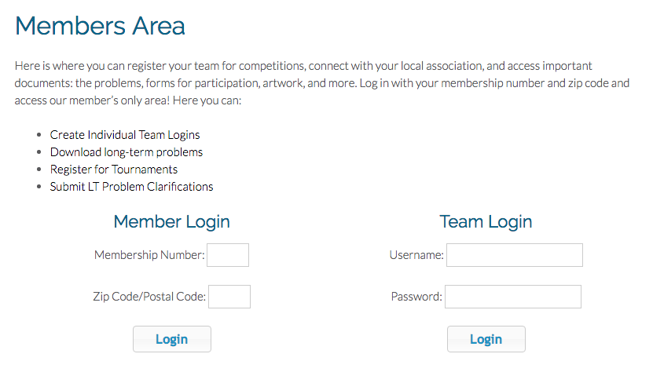
Entering Member Area
Enter Membership # & zip code on Membership
record
Notes:
Memb # 90231
Zip 11111

Slide 48
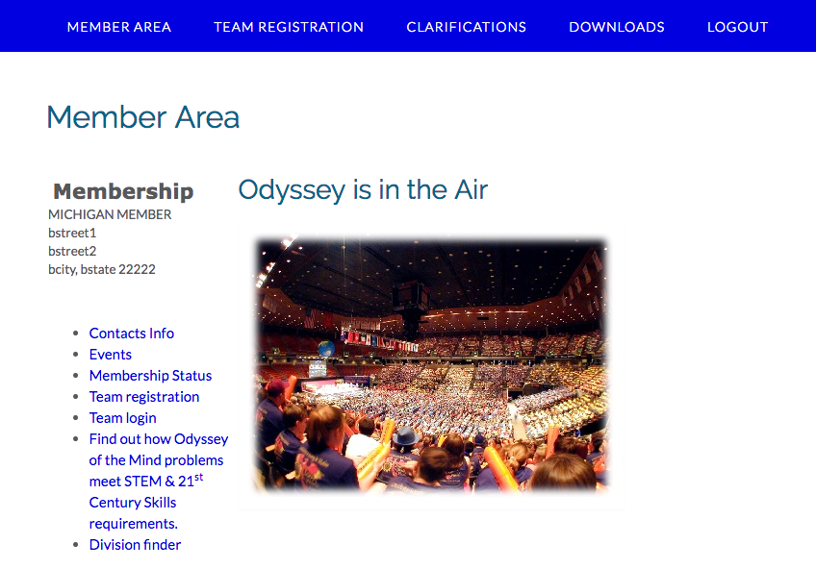
Member Area
Clarifications
Forms &
Problems
Regional &
State Events

Slide 49
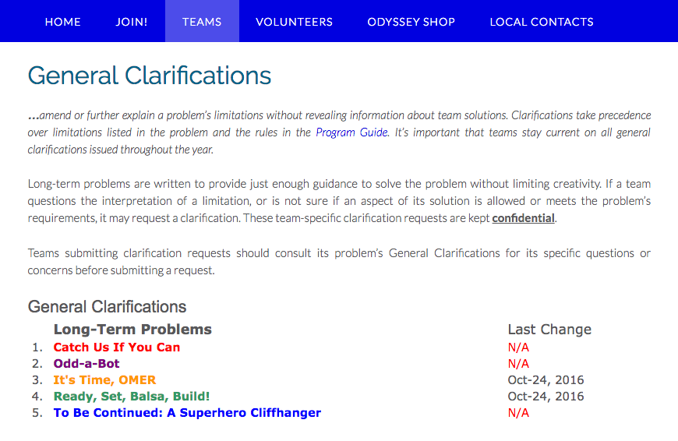
Member Area Continued…
Date of last clarification
Clarifications by problem

Slide 50
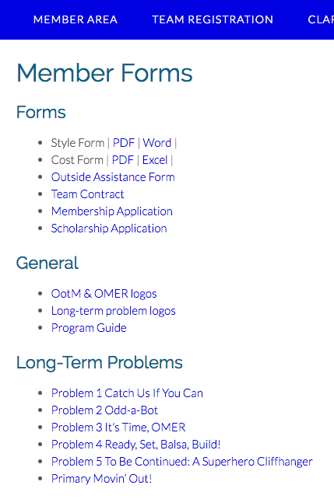
Member Area Continued…
Forms
Team Required lists will be posted later in the year
Scholarship Application
Long-Term
Problems

Slide 51
More Resources
Other helpful resources:
Other Coaches
Membership Coordinator
Printed Materials
Websites
Local Association
  Association & Regional Directors
International Program Headquarters
  General info, videos, books
Problem Procedures
  Usually released in late February Newsletter
PG 54

Slide 52
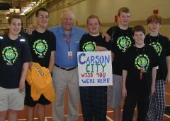
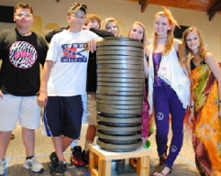
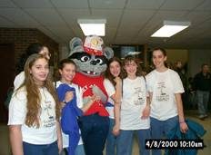


Contact Us
For more information, or to register:
Michigan website:
http://www.miodyssey.com
Association Director: Pamela Gombert
Email: Director@MichiganOdyssey.com
International site
http://www.odysseyofthemind.org
  Odyssey of the Mind Headquarters
  Email: info@odysseyofthemind.org

Slide 53

Odyssey of the Mind
Be Creative!

