Slide 1

MICHIGAN
ODYSSEY OF THE MIND
COACHES’ TRAINING
- Preparing for Competition -
Based on The “Unofficial” On-Line Coaches’ Training - by T.Perkins (VT), J. Otte (NY), & S. Riggs (TX)
& Wisconsin Odyssey of the Mind Coaches Training - wi.odysseyofthemind.org/Documents/CoachesTraining.ppt
Notes:
Introductions
Bathrooms, water fountain, coffee
Hand show old vs new coaches
Anybody totally new to OM

Slide 2


Before We Begin
Two main references in today’s presentation
PG 5
CM 1
Notes:
Show both publications
Program Guide online @ member area
Explain PG & CM notations

Slide 3
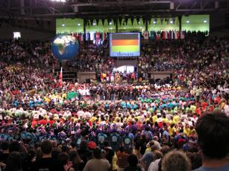
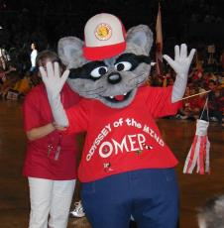
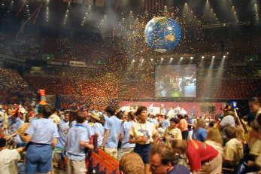
Tournaments
Odyssey of the Mind tournaments are held in the late winter or early spring each year around the world at various levels.
Creativity Unlimited of Michigan hosts the Regional and State Tournament.
Odyssey of the Mind hosts the World Finals!
These tournaments provide an opportunity for teams to present their creative solutions, to be judged against the problem criteria and to see how others solved the same problem!
Although the event is a competition, it is meant to be a time for the teams to be rewarded, meet others and to have FUN!

Slide 4

Tournaments Continued…
Every team presenting a solution is a winner!
However, because a competition model is used, teams are judged for how well and how creatively they satisfy the problem criteria.
From Regional Tournaments the following teams will advance to State:
1 - 6 teams = 1st & 2nd advance
7 - 12 teams = 1st, 2nd & 3rd advance
13 - 18 teams = 1st, 2nd, 3rd & 4th advance
19 + teams = 1st, 2nd, 3rd, 4th & 5th advance
Ranatra Fusca winners
From the State Tournament, teams that place
1st or 2nd as well as Ranatra Fusca recipients
are invited to attend the World Finals
CM 49

Slide 5


How the Scoring Works
Raw Score is the number of points awarded by the judges.
Calculated Score is the proportional number of points awarded for each component (Long-Term, Style, Spontaneous).
The team with the highest Raw Score receives the full possible Calculated Score (200, 100, 50)
Example:
  Team A
  Raw Score – 88
  Team B
  Raw Score – 44
  Team C
  Raw Score 22
  100 %
  50 %
  25 %
  Calc. Score – 200
  Calc. Score – 100
  Calc. Score - 50
PG 22

Slide 6
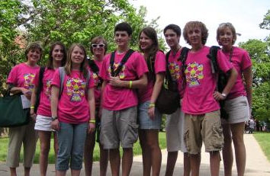
Odyssey of the Mind Recognition
Ranatra Fusca
Presented to teams or individuals who exhibit exceptional creativity, either through some aspect of their problem solution, or an extraordinary idea beyond the problem solution.
OMER Award
Recognizes teams or individuals who demonstrate outstanding sportsmanship, exemplary behavior, and exceptional talent.
Placement & Scoring Notes
Tournament Placements are determined by total score
Teams tie if there is less than a 1 point difference
PG 34

Slide 7
Preparation for Tournament
Practice presenting your solution
Don’t neglect to figure in set-up time
What happens if something goes wrong during setup?
Who handles what tasks during setup?
Is there something someone can do during setup to start the performance?
Time does not stop if the team encounters a problem. (Except for medical emergencies)
Dress rehearsal

Slide 8
Packing and What Not to Forget
Essential items for long term
A repair kit
  Duct tape
Spontaneous practice supplies
Extra set of forms

Slide 9
Paper Work
Be sure to get the following together ahead of time
  Signed Media Release for every team member and coach
  Signed Coach’s Code of Conduct for every coach
  Team forms:
    Completed Style Form (4 copies)
    Completed Cost Form (1 copy)
    Signed Outside Assistance Form (1 copy)
    Completed Team Required List (4 copies)
Bring an extra set, JUST IN CASE!

Slide 10
Style Form
4 copies for Staging Judge
Elaborates Long-Term problem
Relates to the solution’s theme
Team can showcase strengths
Cannot be items already scored as part of Long-Term
Categories:
  Specific Scoring Elements
  Free Choice Elements
  Overall Effect
Be very specific when describing elements on form.
PG Appendix
CM 67

Slide 11
Completing the Style Form
All forms, including the Style form should be filled out by the team, in the team’s own words.
Division I teams may have their coach “scribe” the form but the team needs to be the author.
General choices lead to general or average scoring.
If the team has one costume they are particularly proud of, select the one costume or portion of a costume rather than “costumes”.
Part III is the Summary, it asks the team to briefly describe how the style presentation related to the Long-Term solution.
Remember the Style Judges have only a few minutes to read the summary.
PG 24
CM 36

Slide 12
Choosing Style Items
If the team would like the clown’s overall appearance to be scored - costume, makeup, hairstyle, etc. - it should state “Appearance of the clown.”
If a team would like a specific aspect of the clown scored, it might list on its Style Form, “Appearance of the clown’s costume,” or “Appearance of the clown’s makeup.”
If the team used items in a unique way to make the clown’s costume and would like this scored, it should state “Materials and technique used to make the clown’s costume.”
If the team states “The clown,” the judges will consider all aspects of the clown, including its performance, which could result in a lower score than having specific elements scored.
PG 24
CM 36

Slide 13
Outside Assistance (OA) Form
1 copy for Staging Judge
Only 7 members can contribute to problem solution
Coaches are facilitators
Coaches can assist Div I teams in filling out forms, but must use team’s own words
If OA did occur, list on form, may result in a penalty
Penalty is proportional to amount and type of help given
PG Appendix
CM 68

Slide 14
Cost Form
1 copy for Staging Judge
Must represent everything used during Long-Term & Style
Doesn’t include items not used during presentation
“Garage sale value” if used items
Combine value of small items
Exemptions (see pages 46 - 48 of the Program Guide)
Acquire materials creatively, “the art of scavenging”
Cardboard, duct-tape, even “donations” all have value
PG Appendix
CM 69

Slide 15
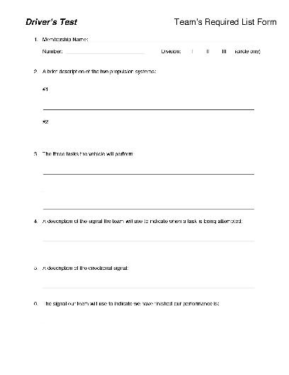
Team’s Required List
4 copies to the Staging Judge
Requirements that must be included on the list are found at the end of Section “B” (The Problem) in each problem.
Hand printed or computer generated on one side of 1 or 2 sheets of 8 ½” X 11” paper.
Check your specific problem to see if this is required
Team’s Required List forms are available in the Member Area of the Odyssey of the Mind website.

Slide 16
Tournament Day Progression
- - - Check In - - -
1 Coach only to Check In area with:
  Signed Media Release Form for every Team Member
  Signed Media Release Form for every Coach
  Signed Coach’s Code of Conduct for every Coach
Coach will receive Team Packet containing:
  Envelope for Staging Area Judge
  Participant Certificates
  Team Programs
  Color coded Spontaneous Ticket (DON’T LOOSE THIS)

Slide 17
Tournament Day Progression
- - - Prop Drop - - -
Check the Tournament Program for the location of your Long-Term problem’s Prop Drop Area
Props my be dropped no earlier the 90 minutes before your scheduled Long-Term performance time
Store your props only in the designated Prop Storage area for you Long-Term problem
Please keep hallways and doors clear for traffic
DO NOT leave cars parked in Prop Drop loading zones even temporarily
Once your Long-Term performance is finished remove your props through the same Prop Drop area as soon as possible to keep hallways clear

Slide 18
Tournament Day Progression
- - - Long-Term Check-In - - -
Teams should report to their Check-In area at least 20 minutes before they are scheduled to compete.
Structure teams should have their structure weighed at least 45 minutes before reporting to the Check-In area.
Props should be moved to Check-In / Pre-Staging Area.
Anyone may help the team transport props and scenery into this area. If broken only the team may fix it.
Staging Area Judge will collect paperwork, check for items that might damage the floor, check for footwear and get a contact number for the coach.
Coaches – This is when you step back and let the team do it’s thing, now is their time to shine!

Slide 19
Tournament Day Progression
- - - Long-Term Staging Area - - -
Once the previous team has finished their presentation the team’s props are moved to the Staging Area.
Anyone may help the team transport props and scenery into this area. If broken only the team may fix it.
Timekeeper will ask the team if flash photography or videotaping is OK, if strobe lights will be used and how the team will signal that they are finished performing.
Head Judge will be identified and the coach will be instructed on where, when and how to pick up scores.
Coaches will be told where to sit during the performance.
Coaches – Wish your team good luck and take a seat.

Slide 20
Tournament Day Progression
- - - Long-Term Performance - - -
Timekeeper will ask the team, “Team, are you ready?”.
Many teams find a creative way to indicate they are ready.
Timekeeper will say “Team begin!” – TIME STARTS NOW
Team ONLY must move props to the performance area and begin their performance. Don’t neglect to figure in set-up time.
  What happens if something goes wrong during setup?
  Who handles what tasks during setup?
  Is there something someone can do during setup to start the performance?
  Time does not stop if the team encounters a problem. (Except for medical emergencies)

Slide 21
Tournament Day Progression
- - - Long-Term Performance - - -
Coaches – Watch out for accidental Outside Assistance.
Wrap it Up - Like the beginning, the end is important! Many teams find a “creative” way to indicate they are finished.
After the performance ends, the judges will talk to the TEAM and ask them questions about their solution. Let the team know to expect it and practice it with them. Coaches need to remember this is a part of the solution. Keep out.
Once the judges are finished with the team anyone my help move the props from the performance area back to the Prop Drop Area and then packed back into you vehicles.
1 (ONE) Coach may pick up the raw Long-Term scores form the Head Judge as soon as they are ready.

Slide 22
Tournament Day Progression
- - - Spontaneous Check-In - - -
All teams will receive a color coded Spontaneous Card when they register in the morning.
Teams and 1 coach should report to the Spontaneous Check-In area 15 minutes before their scheduled Spontaneous time.
Make sure to collect all cellphones, cameras and electronic devices from your team before entering the area. These items are not allowed in the Holding Room.
Team members and coach will go to the Holding Room.
Teams supporters will be directed to a meeting area.
When judge comes to collect the team, the coach will go to meeting area and wait for team to finish.
NO ONE but the team enters the Spontaneous Area.

Slide 23
Tournament Day Progression
- - - Spontaneous Competition - - -
One of the judges will call the teams membership number, team name, LT problem and division
Team members should present the Spontaneous Card to the judge to confirm they have the right team
The judge will escort the team from the Holding Room into the Spontaneous competition area
When the team enters the room they will told which type of problem they will do and must identify the team members who will be participating in the Spontaneous problem
After competing the team will go to the Meeting Area
DO NOT ask the team about the problem, THIS IS A SECRET!

Slide 24
Tournament Day Progression
- - - Awards Ceremony - - -
The Awards Ceremony is usually preceded by “Trading”
  Keep items inexpensive and NOT MESSY; avoid liquids, silly string, pop streamers, air horns, etc.
Before the Awards Ceremony can start the floor must be picked up and teams seated together
Remind your team they are all winners
Remember good sportsmanship
Ranatra Fusca’s are awarded at the end, don’t leave early

Slide 25
What do coaches do on tournament day?
Pick up your team’s registration packet. Read through it and determine your schedule for the day.
Get your team to the Long Term Staging Area about 20 minutes prior to their scheduled LT competition time.
Get your team to the Spontaneous Holding Area about 15 minutes prior to their scheduled Spontaneous competition time. Parents and other supporters should not accompany the team.
Enjoy your team…
  Enjoy other teams…
    Enjoy the day…
      Take pictures
        Start planning for next year…
CM 46

Slide 26
More Resources
Other helpful resources:
Other Coaches
Membership Coordinator
Printed Materials
Websites
Local Association
  Association & Regional Directors
International Program Headquarters
  General info, videos, books
Problem Procedures
  Usually released in late February Newsletter
PG 54

Slide 27
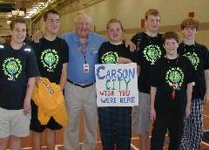
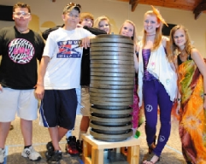
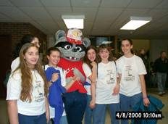
Contact Us
For more information, or to register:
Michigan website:
http://www.miodyssey.com
Association Director: Pamela Gombert
Email: Director@MichiganOdyssey.com
International site
http://www.odysseyofthemind.org
  Odyssey of the Mind Headquarters
  Email: info@odysseyofthemind.org

Slide 28

Odyssey of the Mind
Be Creative!

