Slide 1

MICHIGAN
ODYSSEY OF THE MIND
COACHES’ TRAINING
Based on The “Unofficial” On-Line Coaches’ Training - by T.Perkins (VT), J. Otte (NY), & S. Riggs (TX)
& Wisconsin Odyssey of the Mind Coaches Training - wi.odysseyofthemind.org/Documents/CoachesTraining.ppt
Notes:
Introductions
Bathrooms, water fountain, coffee
Hand show old vs new coaches
Anybody totally new to OM

Slide 2


Before We Begin
Two main references in today’s presentation
PG 5
CM 1
Notes:
Show both publications
Program Guide online @ member area
Explain PG & CM notations

Slide 3
Outline
Components of Odyssey of the Mind
Program Structure
Coaches & Coaching
Long-Term Problem Solving
Do it with Style
Outside Assitance
Spontaneous Problem Solving
Forms, Scoring & Penalties
Competitions
Websites & Resources

Slide 4
Ready?
Set?
Let’s Go!

Slide 5
What is divergent-thinking?
Convergent Problem Solving
For every problem, there is
just one correct answer
Divergent Problem Solving
For many problems, there are
many correct answers
Answer
Answer
Answer
Answer
Answer
Answer
Answer
Answer
Answer
Answer
Answer
Answer
Answer
Answer
Answer
Answer
Answer
Answer
Odyssey of the Mind encourages young people to explore many possible answers and to be creative in finding a solution
Because there are no wrong solutions, teams are free to take calculated risks in attempting to solving the problem
Odyssey of the Mind allows kids to use their imaginations to interpret and solve complex problems in a FUN way!

Slide 6



The Three Components of OotM
Long-Term (LT)
200 Points
Specific rules
Open-Ended
Solutions presented
In skit form (8-min)
Style
50 Points
Elaboration of
Long-Term solution
Pizazz, sparkle, polish
Team chosen elements
Spontaneous
100 Points
On the spot
Anything goes
3 Types: Verbal,
Hands-on, Hybrid
PG 20
CM 1

Slide 7
The Three Components of OotM
Long-Term
+ Style
+ Spontaneous
= Total Score

Slide 8
Program Structure – Memberships
Each membership must
  Pay National Membership fee ( ~ $100 - $135 )
  Pay State Membership fee ( $50 )
  Provide at least one trained judge for Regional and State tournament (if advancing)
Each Team must:
  Pay Regional Tournament fee ( $50 )
  Provide at least one trained judge for Regional and State tournament (if advancing)
  Provide one Volunteer for Regional and State tournament (if advancing)
PG 16
CM 4

Slide 9
Program Structure - Teams
Teams participate within divisions.
A team’s division is based upon the grade level of the team’s oldest member.
  Primary (usually K-2nd grade)
  Div I (every team member in K-5th grade)
  Div II (at least one team member in 6th-8th grade)
  Div III (at least one team member in 9th-12th grade)
  Div IV (all members with high school diplomas and taking at least one college course)
PG 17
CM 7

Slide 10
Program Structure - Teams
Teams of 5-7 students participate in:
  Teams choice of the Long-Term problems for that year
  A Spontaneous problem assigned at competition
A maximum of 7 “minds” can work on the team’s Long-Term problem. (In other words, No Outside Assistance!)
Only 5 team members may participate in Spontaneous problem (Team members will choose which 5) Additional team members may observe Spontaneous competition.
PG 18

Slide 11

Typical Timeline
Sep – Nov Membership Coordinator:
        Purchase memberships
        Form teams, recruit coaches
        Pay State team fee
Nov - Dec Coach: Attend coaches training
Nov - Mar Team: Work on LT solution, practice Spontaneous
Dec - Jan Coach: Sign-up for tournament (early if possible)
Jan 10 Coach: Deadline to register for State and Region Deadline to register Judges & Volunteers
Feb Judges: Attend Judges’ training
Feb 16 Regions 1 & 4 Tournaments
Feb 23 Regions 2, 3 & 5 Tournaments
Mar 16 Michigan State Tournament: Middleville, MI
May 23-26 World Finals: Michigan State University

Slide 12
What is the role of the coach?
Schedule meetings & Organize snacks – Busy minds need fuel
Facilitator – help team to:
  Set goals, develop a timeline, track tasks & deadlines
  Understand problem including scoring and clarifications
  Take notes - without making suggestions or directing
  Lead brainstorming sessions - without injecting ideas
  Bring in “experts” to discuss and teach skills
Teach basic skills - Sewing, carpentry, painting, make-up, etc …
Ask open-ended QUESTIONS (to help team focus)
Guide team in Spontaneous practice at every meeting
Guide team through forms
All Around Go-fer & field trip coordinator
PG 7
CM 9

Slide 13
Tips and Advice
Arrange for a Co-Coach or back up person for the team.
Have the team develop a timeline and stick to it.
Learn to recognize burnout and when to lighten up.
Make (and bring to competition) backups of everything -- forms, tape, batteries, etc.
Know the OotM Long-Term problem and the OotM Program Guide inside out, upside down and backwards.
Plan on mistakes, disappointments, and disagreements and decide early how you, as a team, will handle them.
CM 9

Slide 14
Tips and Advice Continued …
Learn how to ask questions. Become an expert at this skill.
Be a real resource person. Take the team on “field trips”
Teach skills and attitudes to help anticipate problems.
Practice spontaneous as much as Long-Term and Style.
Practice reacting to mistakes - accidents often happen.
Always answer a question with a question.
Help the team develop confidence in risk taking.
CM 9

Slide 15
Tips and Advice Continued …
Look at the answer or solution. Have team members ask:
  Is it of high quality?
    How original is it?
      Is it the first thing you think of?
        Is it the first thing others will think of?
          If so, is it creative?
Remember that it is the team’s attention to details that will differentiate good solutions from great solutions.
CM 9

Slide 16
Coaching Do’s & Don’ts
Do teach your team the creative problem-solving process and use it throughout the problem solution
Don't get disturbed when teams make mistakes along the way. This is part of the OM learning process.
Do help them to learn how to evaluate their ideas and progress continually throughout each aspect of the problem solution
Don't tell them how to solve the problem, but rather ask questions which help them think it through
CM 11

Slide 17
Coaching Do’s & Don’ts Continued …
Do help students to understand that winning is not the goal. The process of getting there is the most important thing -- not the competition.
Don't make them feel they have failed if they don't win. Failing is only when they won't try again.
Do help students to see and recognize the abilities of each team member and encourage team members to capitalize on the individual strengths of ALL
Don't allow any criticism of personalities or physical attributes -- no cutting remarks
CM 11

Slide 18
Coaching Do’s & Don’ts Continued …
Do set an example of good sportsmanship and behavior. Be a good role model for your team members and others.
Don't limit creativity by setting restrictions which are too tight or which reflect your own, perhaps limited, vision.
Don't get uptight. Relax and remember that the team members are the ones who have to know everything or find out.
Do relax and enjoy seeing these young, creative minds at work!!
CM 11

Slide 19
The First Five - Meeting #1
Meet with team and parents to explain program and set team goals
Discuss the process, give dates for tournaments
Go over the time commitment and responsibility of being on the team
Stress regular attendance at meetings
Explain Outside Assistance
Review behavioral expectations
Talk about difference between “winning” and “succeeding”
Set a meeting schedule
PG 9
CM 14

Slide 20
The First Five - Meeting #2 - 5
Every meeting
  Incorporate a team-building activity
  Practice a couple Spontaneous problems
#2 Talk about skills and interests of team members
  Explain Spontaneous and relevance to scoring
#3 Have team decide on Long-Term problem (vote?)
  Brainstorm possible solutions to LT problem
#4 Read the Specific Long-Term problem rules
#5 Brainstorm list of tasks to accomplish and timeline
  Assign tasks and discuss team responsibilities
  Ask for help if you need it
PG 10
CM 14

Slide 21
Coaches “Bill of Rights”
You have the right to ……
  Expect appropriate behavior from all your team members
  Expect team members to attend scheduled meetings
  Expect help from your team members’ parents
  Expect parents to share the costs of creating solution
  Remove a child from a meeting if they can’t behave
  Call a child’s parent’s if a problem occurs or recurs
  Remove a child from your OotM team if attempts to modify their behavior fail
  Have a life outside of Odyssey of the Mind
CM 16

Slide 22
Teambuilding
It is important that your group comes together and functions as a team. Important decisions should be made together.
Incorporate some team-building games into each practice session, especially early in the season. This will build team trust, and teach students to work together to solve problems.
Do not allow criticism of people or their ideas. It is okay to evaluate ideas on their merits, but it must be done constructively.
Celebrate milestones, breakthroughs and accomplishments.
Once an idea is generated and discussed, it is no longer owned by the originator….it is the TEAM’S idea.
PG 11
CM 15 & 43

Slide 23
Long-Term
Problem Solving

Slide 24
What's needed to get started with our Long-Term problem?
There are 3 major information resources that are available to you, as a coach and your Odyssey of the Mind team
  Program Guide (available on the official website or through your membership coordinator)
  Long-Term Problem (available from your membership coordinator)
  Clarifications general and team (available on the Odyssey of the Mind website, through your coordinator, or through your State Association, released throughout the season)

Slide 25
The Long-Term Problems
  Six new Long-Term problems are written by Creative Competitions, Inc each year.
  There is a cost limit to each problem (usually ~ $125 - $145)
  Solutions cannot be “bought”, they must be designed and built by the team
  All have a theme with a skit and are performed in 8 minutes
When teams start to work on the long term problem varies. Start as early as possible
If there is a question not answered in the Program Guide or the Long-Term Problem the team may request a clarification
PG 20
CM 1

Slide 26

The Long-Term Problems Continued…
Problem #1 - Vehicle – OMER to the Rescue Again
Teams design, build and operate one or more vehicles. Sometimes they’re small, other times they’re big enough to ride on and transport other items. Generally the vehicles are scored on their propulsion system, and for traveling and completing different tasks.
PG 20
CM 3

Slide 27
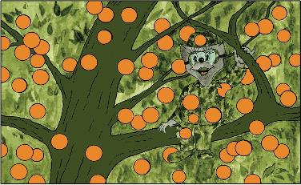
The Long-Term Problems Continued…
Problem #2 - Technical – Hide in Plain Sight
Teams are scored for performance elements as well as for some type of technical achievement. Usually, this problem requires the team to create one or more devices that perform certain functions or tasks.
PG 20
CM 3

Slide 28
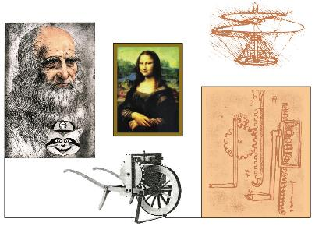
The Long-Term Problems Continued…
Problem #3 - Classics - Leonardo’s Workshop
This is a performance problem based on something “classical.” It could involve mythology, art, music, archaeology, or anything else that is classical in nature.
PG 20
CM 3

Slide 29
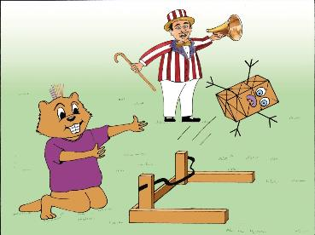
The Long-Term Problems Continued…
Problem #4 - Structure – Structure Toss
Teams design and build a structure out of only balsa wood and glue. They test the structure by adding Olympic-size weights until it breaks. Each year there is an element of the problem that sets it apart from other years, for example, having the structure endure the impact of a ball propelled down a ramp.
PG 20
CM 3

Slide 30
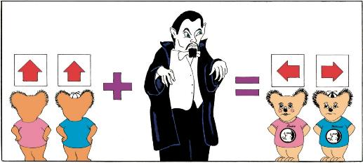
The Long-Term Problems Continued…
Problem #5 - Theatrical – Opposites Distract
This is strictly a performance problem, where scoring is
based mostly on the performance and elements within the performance. It sometimes requires a specific character, sometimes humor, sometimes an original story, but it’s always fun!
PG 21
CM 3

Slide 31
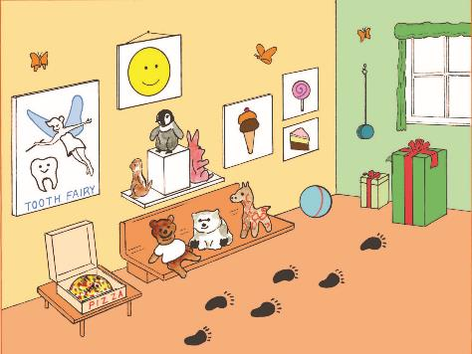
The Long-Term Problems Continued…
Primary Problem – Museum Makers
Non-Competitive
Designed to introduce younger students (Grades K-2)
to the creative problem solving
process.
PG 25
CM 3

Slide 32

Parts of a Long-Term Problem
Introduction
A. The Problem
B. Limitations
Notes:
Problem section outlines Spirit of Problem
Limitations gives specific expectations

Slide 33
Parts of a Long-Term Problem
E. Penalties
F. Style Scoring
C. Site, Setup &
Competition
G. TD Provides
H. Team Provides
D. Long-Term Scoring
I. Glossary
Notes:
Site & setup gives minimum specs
Scoring specifics – where will you get the most bang for your buck
Penalties lists range of possible
Style – 5 required style elements, 1 is overall
TD provides – minimum provisions, don’t ask for site specifics. Room unavailable?

Slide 34
How to solve the problem
Step 1 - Read the Problem, then read it again!
  Go through each section of the problem carefully
  Examine the scoring elements carefully
Step 2 - Brainstorm Possible Solutions
  Generate lots of ideas and make a list
  Encourage wild, creative solutions
Step 3 - Refine and Evaluate Ideas
  Discuss and evaluate ideas, but don’t criticize
  Which ideas does the team like best?
Step 5 - Determine Tasks and Timeline
  What types of tasks, skills, props, contraptions, are needed
  Make a basic time-line and assign jobs
CM 23

Slide 35
How to solve the problem Continued…
Step 5 - Begin Construction
  Start building, recording, evaluating ideas as they arise
  Test the solution. Does it work? How could it work better?
  Continuously refine and revise.
Step 6 - Put it Together (At least one month before tournament)
  As props and tasks are completed, test them thoroughly
  Continue to refine & revise your solution
    Does it work? Is there a better way?
    Does the solution still fit the problem?
Step 7 - Finish Up and Practice
  Test things out… do they work? Revise and refine.
  What happens if something goes wrong?
  Practice the whole skit and check the timing.
CM 32

Slide 36
Submitting a Clarification
When a team has a question about the Long Term problem that is not covered in the problem or the Program Guide, the team may submit a request for clarification.
General Clarifications amend or further explain a problem’s limitation. Team members can find general clarifications on the www.odysseyofthemind.com website.
Team Specific Clarifications are confidential since teams must describe details of their solution to ascertain an accurate reply. If a team receives a clarification they must have copies of the clarification e-mail for the judges at competition to avoid any discrepancies.
Only problem clarifications issued by CCI are official.
CM 21

Slide 37
Submitting a Clarification continued…
Clarifications should be submitted online at online at www.odysseyofthemind.com
Always reference the part of the problem that you feel needs clarifying
Do not ask for clarifications before rereading the problem
Check online for General Clarifications first
Reread the Program Guide before submitting your clarification
The cut-off dates for clarifications that will be honored at a Michigan tournament are:
  Midnight on the Friday before a Regional Tournament
  Midnight on the Wednesday before a State Finals Tournament
CM 21

Slide 38
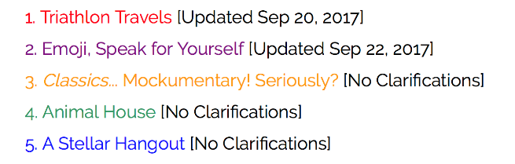


Submitting a Clarification continued…
To view current clarifications or submit a new clarification, go to www.odysseyofthemind.com
  Under the "TEAMS" menu go to "Members Area"
  Login using the username and password that was sent to you with your registration confirmation
  Select the problem that you are interested in
  Notes dates of recent clarifications are listed
To view current clarifications or submit a new clarification, go to www.odysseyofthemind.com
  Under the "TEAMS" menu go to "Members Area"
  Login using the username and password that was sent to you with your registration confirmation
  Select the problem that you are interested in
  Notes dates of recent clarifications are listed
CM 21

Slide 39
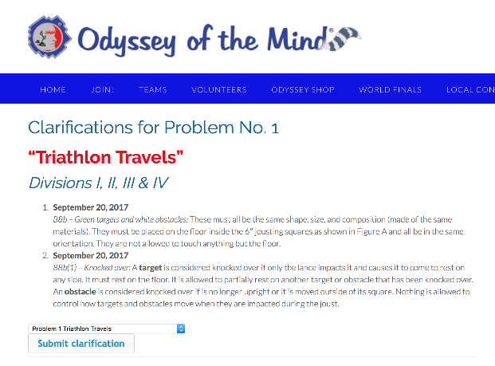
Submitting a Clarification continued…
If you wish to submit a new clarification, from the dropdown menu, select your problem and select "Submit clarification"
CM 21

Slide 40
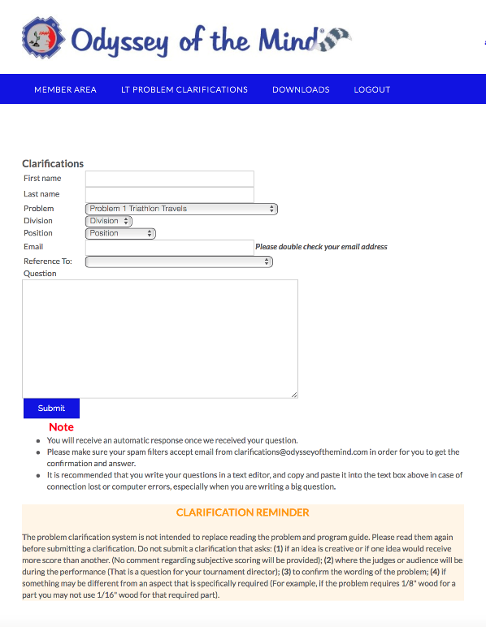
Submitting a Clarification continued…
Complete the required information and select “Submit”
Clarification responses may simply refer you to the portion of the problem or Program Guide that answers the question
CM 21

Slide 41



Do it with Style

Slide 42
Style
Style is the place for the team to
showcase their strengths and talents.
Style is the elaboration of the Long-Term Problem. It is how the team makes their solution stand out from the rest. Style is presented during their Long-Term Problem Solution performance. What makes this performance really shine?
  Artistic design, music, songs, choreography
  Construction, creative use of materials
  Humor, rhyme …….
5 Categories (some mandatory, some team-choice, overall)
  Choose carefully and BE SPECIFIC!
PG 22
CM 35

Slide 43
Types of Style
Mandatory Style categories:
Usually each problem will include one or two mandatory Style categories. These are categories that are scored in every team’s solution for that problem
Free choice of team:
For these categories, teams cannot select anything that is already being scored; however, they can list a different aspect of something already being scored.
Overall Effect:
How well all of the Style elements come together to enhance the presentation of the long-term solution.
PG 23
CM 35

Slide 44
Common Style Categories
Painting or artwork
Make-up or hair
Costumes
Props
Songs or music
Rhythm or rhymes
Sound effects
Poems or chants
Decorations
Original Poetry
Membership Sign
Scenery or Set
Dancing or marching
Humor
Materials or technique
"Details"
Descriptive prose
Narration
Character interaction
Lighting
Etc, etc, etc…..
PG 24
CM 38

Slide 45
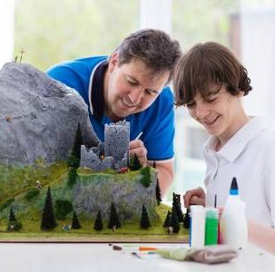
Outside
ASSISTANCE!

Slide 46
Outside Assistance (OA)
OotM is Hands-On for Kids,
but Hands-Off for Adults!
OUTSIDE
ASSISTANCE
One of the most important parts of OotM is that the team must conceive, design, construct, and perform their own ideas. Help external to the team is termed “Outside Assistance”.
The solution is the team’s design, their work, their performance, and their score. The team is responsible for their results, not the coach.
It’s VERY important that parents know OA rules too!
PG 45
CM 19
Notes:
Just a reminder………
We’ll go over this in depth later

Slide 47
Is It OA or Not OA?
Outside Assistance
A team decides it will center its skit on a CELL theme. The coach gives the team members a homework assignment to come up with as many words as possible that contain the word CELL, such as cellophane, cellular phone, etc.
Answer: Not OA – Although the coach should not give the team any examples, the assignment is one of the types of things the coach should do to help the team develop its creativity.
Rationale: It is not OA for a coach to give a homework assignment that gets the kids to think more creatively about an initial idea that they came up with.
CM 20
Notes:
47

Slide 48
Is It OA or Not OA?
Outside Assistance
A Division I team is spray-painting a prop and the coach holds a team member’s hand for about 2 seconds (out of a 30-minute job).
Answer: It is OA – The coach may not help spray paint anything used in the solution. However, the coach may teach the team member how to spray paint by using something that is not part of the solution such as a scrap piece of wood.
Rationale: It is not OA for the coach to teach a team member the proper way to spray paint on a practice/scrap piece
CM 20
Notes:
48

Slide 49
Is It OA or Not OA?
Outside Assistance
A goal for a team is to learn how to take a complex problem apart, test each component in a controlled manner, then reintegrate the resulting solution and validate if it performed as expected. The coach builds the jigs and the tester.
Answer: Not OA – For testers; It is OA – For jigs.
Rationale: Anyone may make a tester but only the team may make jigs because they are construction aids.
JIGS are used as construction aids. Example: something constructed to hold parts of the solution together so they can be glued in place. This must be built solely by the team as it is part of the solution.
TESTERS are used to test the solution. Example: the crusher board used in Problem 4 is a tester and can be built by anyone.
CM 20
Notes:
49

Slide 50
Is It OA or Not OA?
Outside Assistance
In a team’s long-term performance their vehicle will mark the floor. At the beginning of the performance a parent lays down a covering to protect the floor.
Answer: It is OA. The team may have help with prop movement at any time except during the timed competition period.
Rationale: Only team members can move items out of the Staging Area
CM 20
Notes:
50

Slide 51
Outside Assistance (OA) Take two …
OotM is Hands-On for Kids,
but Hands-Off for Adults!
OUTSIDE
ASSISTANCE
Team’s design
Team’s work
Team’s words
Team’s performance
Team’s score
Team’s results

Slide 52
Outside Assistance (OA)
A Few Last Words ….
OA carries with it two possible results:
Adversely affect the potential success of the team’s solution because they must disclose any assistance on the Outside Assistance Form which WILL result in penalty points
OR
Teach every team member to LIE when signing the Outside Assistance Form

Slide 53

Spontaneous
Problem Solving

Slide 54
Spontaneous Problem
Spontaneous problems come in three types:
  Verbal - problems require verbal responses. They may incorporate improvisation or dramatization. Teams are scored for common and creative responses.
  Hands-on - problems require teams to physically create a tangible solution. Each problem has its own specific scoring categories.
  Verbal/Hands-on (Hybrid) – problems require team to create a tangible solution and include some type of verbal component. Teams are scored on both tangible solution and verbal presentation.
PG 26
CM 39

Slide 55
Spontaneous Problem Continued….
Verbal Spontaneous Problems
Think “outside the box”, go for unusual and creative
Use alternate definitions
    Example: Name something green
    Common answers; trees, grass, leaves
    Uncommon; solar power, GreenPeace, greenhorns
Use word play
Example: “I used to be Snow White but I drifted”
If you are stuck give a common or repeated answer
Limited number of responses gives time for thought
Stockpile answers

Slide 56
Spontaneous Problem Continued….
Hands-On Spontaneous Problems
Look carefully at the problem and ask questions
Do you need multiples of the SAME thing
Some materials are there to distract
If you have tools can they be part of the solution
Can you reach over, under, around, through
Does the weight always have to go on the top
Can the materials be altered, reinforced, repurposed
Have your team practice finding ways to reinforce, attach, lengthen, strengthen assorted materials. Think paper, straws, paper clips, mailing labels, yarn…

Slide 57
Spontaneous Problem Continued….
Think
Brainstorm possible solutions
Remember that all ideas are team property
Listen to your teammates and build on their ideas
Plan
How are we going to execute our solution
What materials do we use and how
Who will do what and when
Test
Is it going to work, do we need to adjust
Act
Present for score

Slide 58
Spontaneous Problem Continued….
PRACTICE … PRACTICE … PRACTICE
  Practice all three types, you don’t know what type of problem you’ll get at competition
  Do several spontaneous problems at each meeting
  Work together rather than apart
  Critique the performance (Coaches: Hints are fine here!)
  Have each team member specialize in something
    Analyze scoring
    Problem Reader
    Timekeeper
    Organizer/Delegator

Slide 59

Now let’s get
Spontaneous!!!

Slide 60

Forms, Scoring
& Penalties

Slide 61
Style Form
4 copies for Staging Judge
Elaborates Long-Term problem
Relates to the solution’s theme
Team can showcase strengths
Cannot be items already scored as part of Long-Term
Categories:
  Specific Scoring Elements
  Free Choice Elements
  Overall Effect
Be very specific when describing elements on form.
PG Appendix
CM 67

Slide 62
Completing the Style Form
All forms, including the Style form should be filled out by the team, in the team’s own words
Division I teams may have their coach “scribe” the form but the team needs to be the author
General choices lead to general or average scoring, be specific about what you want scored
If the team has one costume they are particularly proud of, select the one costume or portion of a costume rather than “costumes”
Part III is the Summary, it asks the team to briefly describe how the style presentation related to the Long-Term solution
Remember the Style Judges have only a few minutes to read the summary
PG 24
CM 36

Slide 63
Outside Assistance (OA) Form
1 copy for Staging Judge
Only 7 members can contribute to problem solution
Coaches are facilitators
Coaches can assist Div I teams in filling out forms, but must use team’s own words
If OA did occur, list on form, may result in a penalty
Penalty is proportional to amount and type of help given
PG Appendix
CM 68

Slide 64
Cost Form
1 copy for Staging Judge
Must represent everything used during Long-Term & Style
Doesn’t include items not used during presentation
“Garage sale value” if used items
Combine value of small items
Exemptions (see pages 46-48 of the Program Guide)
Acquire materials creatively, “the art of scavenging”
Cardboard, duct-tape, even “donations” all have value
PG Appendix
CM 69

Slide 65
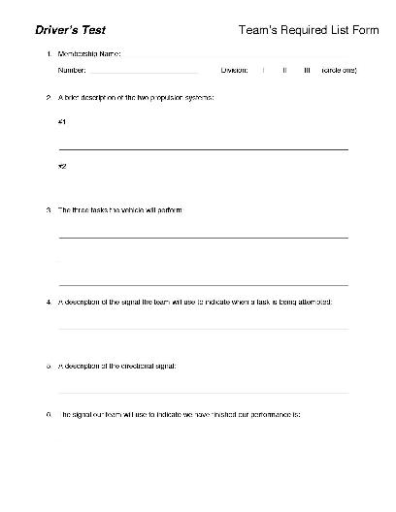
Team’s Required List
4 copies to the Staging Judge
Requirements that must be included on the list are found at the end of Section “B” (The Problem) in each problem.
Hand printed or computer generated on one side of 1 or 2 sheets of 8 ½” X 11” paper.
Check your specific problem to see if this is required
Team’s Required List forms are available in the Member Area of the Odyssey of the Mind website.

Slide 66
How the Scoring Works
Raw Score is the number of points awarded by the judges.
Calculated Score is the proportional number of points awarded for each component (Long-Term, Style, Spontaneous).
The team with the highest Raw Score receives the full possible Calculated Score (200, 100, 50)
Example:
  Team A
  Raw Score – 88
  Team B
  Raw Score – 44
  Team C
  Raw Score 22
  100 %
  50 %
  25 %
  Calc. Score – 200
  Calc. Score – 100
  Calc. Score - 50
PG 22

Slide 67
Penalties
Penalties are designed to prevent teams from bending or breaking
the rules, creating a safety hazard, interfering with other teams,
delaying competition or misbehaving.
  Spirit of the Problem – Aimed at preventing teams from circumventing the intention of the rules in either Long-Term or Spontaneous
      Penalty between 1 to 100 points
  Unsportsmanlike Conduct – For intentionally (or even unintentionally) impairing another team’s solution, disruptive behavior, inappropriate language, damage to facilities. Penalties can be applied retroactively.
      Penalty between 1 to 100 points
PG 44

Slide 68
Penalties Continued…
  Outside Assistance – If team receives help from anyone. This applies to audience as well. Thus teams shouldn’t encourage audience participation
      Penalty between 1 to 100 points
  Incorrect / Missing Membership Sign
      Penalty between 1 to 15 points
  Over Cost Limit – Materials over cost limit
      Penalty between 1 to 100 points
  Over Time Limit – For each 10 seconds or fraction
      Penalty 5 points
  Individual problems may have other penalties
PG 44

Slide 69

It’s Tournament
!!! Time !!!

Slide 70
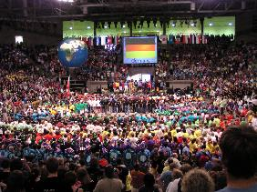
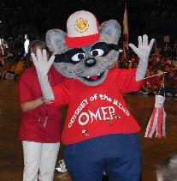
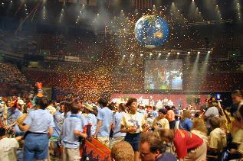
Tournaments
Odyssey of the Mind tournaments are held in the spring of
each year around the world at various levels.
Creativity Unlimited of Michigan hosts the MI State Tournament.
Odyssey of the Mind hosts the World Finals!
These tournaments provide an opportunity for teams to present their creative solutions, to be judged against the problem criteria and to see how others solved the same problem!
Although the event is a competition, it is meant to be a time for the teams to be rewarded, meet others and to have FUN!

Slide 71

Tournaments Continued…
Every team presenting a solution is a winner!
However, because a competition model is used, teams are judged for how well and how creatively they satisfy the problem criteria.
From Regional Tournaments the following teams will advance to State:
1 - 6 teams = 1st & 2nd advance
7 - 12 teams = 1st, 2nd & 3rd advance
13 - 18 teams = 1st, 2nd, 3rd & 4th advance
19 ⁺ teams = 1st, 2nd, 3rd, 4th & 5th advance
Ranatra Fusca winners
From the State Tournament, teams that place
1st or 2nd as well as Ranatra Fusca recipients
are invited to attend the World Finals
CM 49

Slide 72
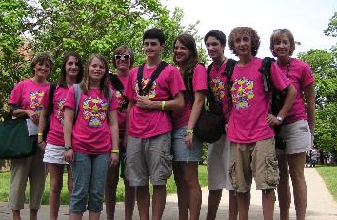
Odyssey of the Mind Recognitions
Ranatra Fusca
Presented to teams or individuals who exhibit exceptional creativity, either through some aspect of their problem solution, or an extraordinary idea beyond the problem solution.
OMER Award
Recognizes teams or individuals who demonstrate outstanding sportsmanship, exemplary behavior, and exceptional talent.
Placement & Scoring Notes
Tournament Placements are determined by total score
Teams tie if there is less than a 1 point difference
PG 34

Slide 73
Tournament Day Progression
- - - Check In - - -
1 Coach only to Check In area with:
  Signed Media Release Form for every Team Member
  Signed Media Release Form for every Coach
  Signed Coach’s Code of Conduct for every Coach
Coach will receive Team Packet containing:
  Participant Certificates
  Team Programs
  Color coded Spontaneous Ticket (DON’T LOSE THIS)

Slide 74
Tournament Day Progression
- - - Prop Drop - - -
Check the Tournament Program for the location of your Long-Term problem’s Prop Drop Area
Props my be dropped no earlier the 90 minutes before your scheduled Long-Term performance time
Store your props only in the designated Prop Storage area for you Long-Term problem
Please keep hallways and doors clear for traffic
DO NOT leave cars parked in Prop Drop loading zones even temporarily
Once your Long-Term performance is finished remove your props through the same Prop Drop area as soon as possible to keep hallways clear

Slide 75
Tournament Day Progression
- - - Long-Term Check-In - - -
Teams should report to their Check-In area at least 20 minutes before they are scheduled to compete.
Structure teams should have their structure weighed at least 45 minutes before reporting to the Check-In area.
Props should be moved to Check-In / Pre-Staging Area.
Anyone may help the team transport props and scenery into this area. If broken only the team may fix it.
Staging Area Judge will collect paperwork, check for items that might damage the floor, check for footwear and get a contact number for the coach.
Coaches – This is when you step back and let the team do it’s thing, now is their time to shine!

Slide 76
Tournament Day Progression
- - - Long-Term Staging Area - - -
Once the previous team has finished their presentation the props are moved to the Staging Area.
Anyone may help the team transport props and scenery into this area. If broken only the team may fix it.
Timekeeper will ask the team if flash photography or videotaping is OK, if strobe lights will be used and how the team will signal that they are finished performing.
Head Judge will be identified and the coach will be instructed on where, when and how to pick up scores.
Coaches will be told where to sit during the performance.
Coaches – Wish your team good luck and take a seat.

Slide 77
Tournament Day Progression
- - - Long-Term Performance - - -
Timekeeper will ask the team, “Team, are you ready?”.
Many teams find a creative way to indicate they are ready.
Timekeeper will say “Team begin!” – TIME STARTS NOW
Team ONLY must move props to the performance area and begin their performance. Don’t neglect to figure in set-up time.
  What happens if something goes wrong during setup?
  Who handles what tasks during setup?
  Is there something someone can do during setup to start the performance?
  Time does not stop if the team encounters a problem. (Except for medical emergencies)

Slide 78
Tournament Day Progression
- - - Long-Term Performance - - -
Coaches – Watch out for accidental Outside Assistance.
Wrap it Up - Like the beginning, the end is important! Many teams find a “creative” way to indicate they are finished.
After the performance ends, the judges will talk to the TEAM and ask them questions about their solution. Let the team know to expect it and practice it with them. Coaches need to remember this is a part of the solution. Keep out.
Once the judges are finished with the team anyone my help move the props from the performance area back to the Prop Drop Area and then packed back into you vehicles.
1 (ONE) Coach may pick up the raw Long-Term scores form the Head Judge as soon as they are ready.

Slide 79
Tournament Day Progression
- - - Spontaneous Check-In - - -
All teams will receive a color coded Spontaneous Card when they register in the morning.
Teams and 1 coach should report to the Spontaneous Check-In area 15 minutes before their scheduled Spontaneous time.
Make sure to collect all cellphones, cameras and electronic devices from your team before entering the area.
Team members and coach will go to Holding Room
Teams supporters will be directed to meeting area
When judge comes to collect the team, the coach will go to meeting area and wait for team to finish
NO ONE but the team enters the Spontaneous Area

Slide 80
Tournament Day Progression
- - - Spontaneous Competition - - -
One of the judges will call the teams membership number, team name, LT problem and division
Team members should present the Spontaneous Card to the judge to confirm they have the right team
The judge will escort the team from the Holding Room into the Spontaneous competition area
When the team enters the room they will be told which type of problem they will do and must identify the team members who will be participating in the Spontaneous problem
After competing the team will go to the Meeting Area
DO NOT ask the team about the problem, THIS IS A SECRET!

Slide 81
Tournament Day Progression
- - - Awards Ceremony - - -
The Awards Ceremony is usually preceded by “Trading”
  Keep items inexpensive and NOT MESSY; avoid liquids, silly string, pop streamers, air horns, etc.
Before the Awards Ceremony can start the floor must be picked up and teams seated together
Remind your team they are all winners
Remember good sportsmanship
Ranatra Fusca’s are awarded at the end, don’t leave early

Slide 82
What do coaches do on tournament day?
Pick up your team’s registration packet. Read through it and determine your schedule for the day.
Get your team to the Long Term Staging Area about 20 min
prior to their scheduled LT competition time.
Get your team to the Spontaneous Holding Area about 15 min prior to their scheduled Spontaneous competition time. Parents and other supporters should not accompany the team.
Enjoy your team…
  Enjoy other teams…
    Enjoy the day…
      Start planning for next year…
CM 46

Slide 83
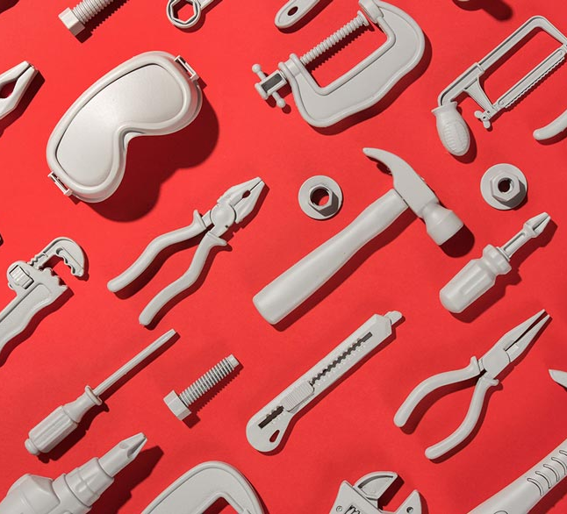
Websites &
Resources

Slide 84
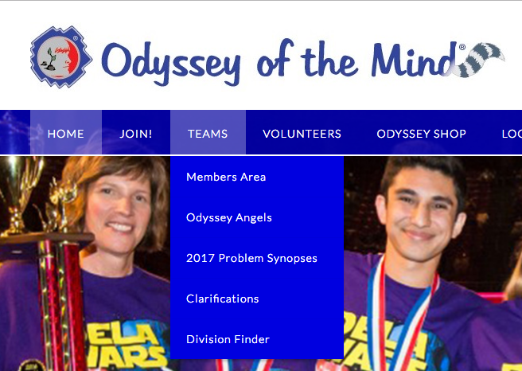
Odyssey of the Mind Website www.OdysseyoftheMind.com
National Membership Registration
Member Area
General Clarifications
Notes:
Show first two areas online
Go to member area on next slide

Slide 85
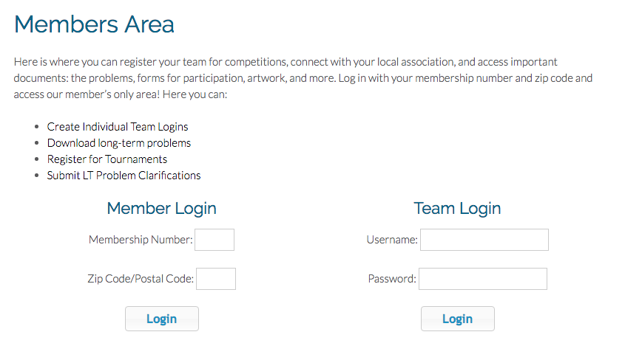
Entering Member Area
Enter Membership # & zip code on Membership
record
Notes:
Memb # 90231
Zip 11111

Slide 86
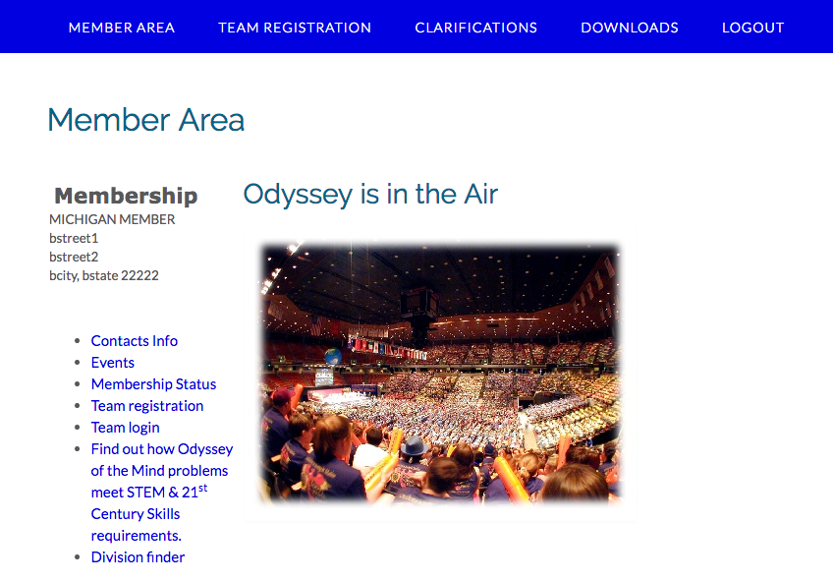
Member Area
Clarifications
Forms &
Problems
Regional &
State Events

Slide 87
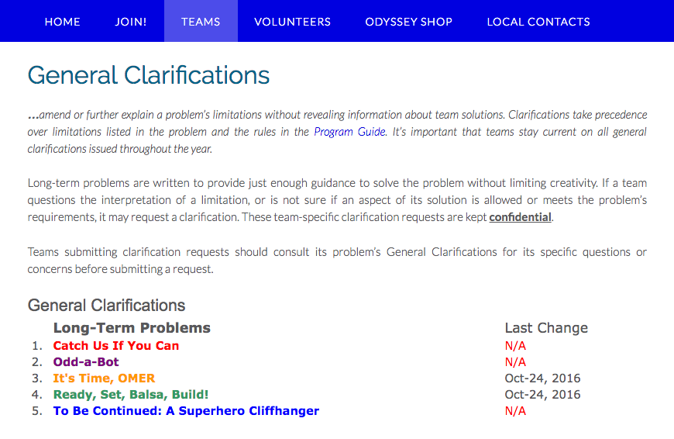
Member Area Continued…
Date of last clarification
Clarifications by problem

Slide 88
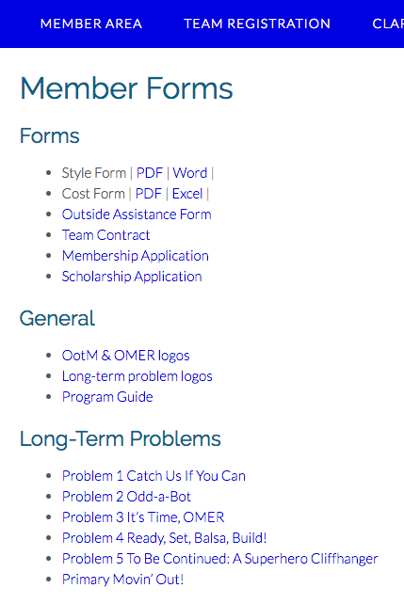
Member Area Continued…
Forms
Team Required lists will be posted later in the year
Scholarship Application
Long-Term
Problems

Slide 89
More Resources
Other helpful resources:
Other Coaches
Membership Coordinator
Printed Materials
Websites
Local Association
  Association & Regional Directors
International Program Headquarters
  General info, videos, books
Problem Procedures
  Usually released in late February Newsletter
PG 54

Slide 90
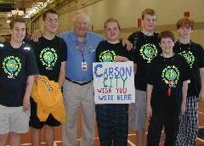
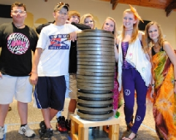
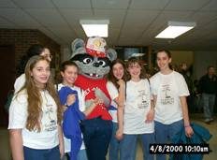
Contact Us
For more information, or to register:
Michigan website:
http://www.miodyssey.com
Association Director: Pamela Gombert
Email: Director@MichiganOdyssey.com
International site
http://www.odysseyofthemind.org
  Odyssey of the Mind Headquarters
  Email: info@odysseyofthemind.org

Slide 91

Odyssey of the Mind
Be Creative!

